Slide 1


Predictive maintenance using ML for printheads
Anthony Atallah
Profs encadrant:
M.Wolf Beat
M.Rodriguez Llorente Fernando
M.Balestra Gioele

Slide 2
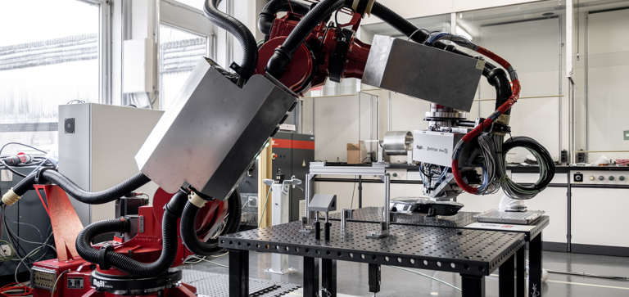
Context
Leader in innovative inkjet and digital printing (2D, 3D, biomedical, electronic).
Expertise across the entire chain: inks, print heads, processes, pre/post-print treatments.

Slide 3
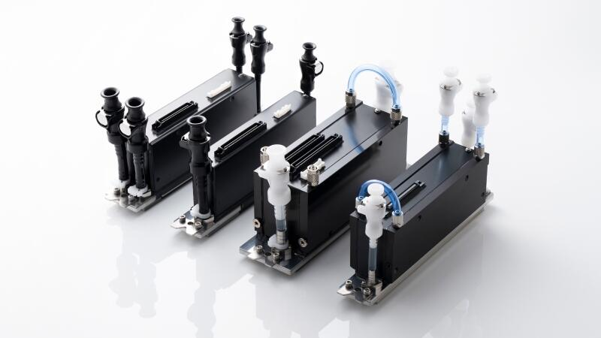
Problematic
The performance of printheads deteriorates over time (defects, wear, contamination).
Maintenance is complex: it depends on the condition of the nozzles, the type and age of the ink.
There is a need for early and reliable fault detection.

Slide 4
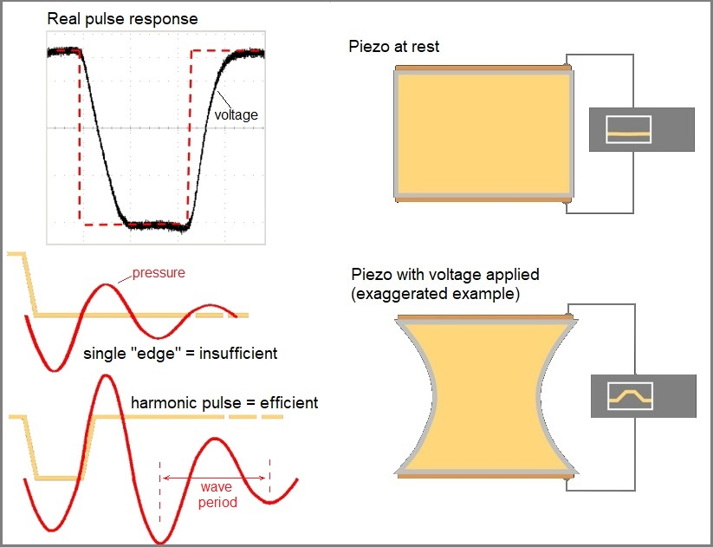
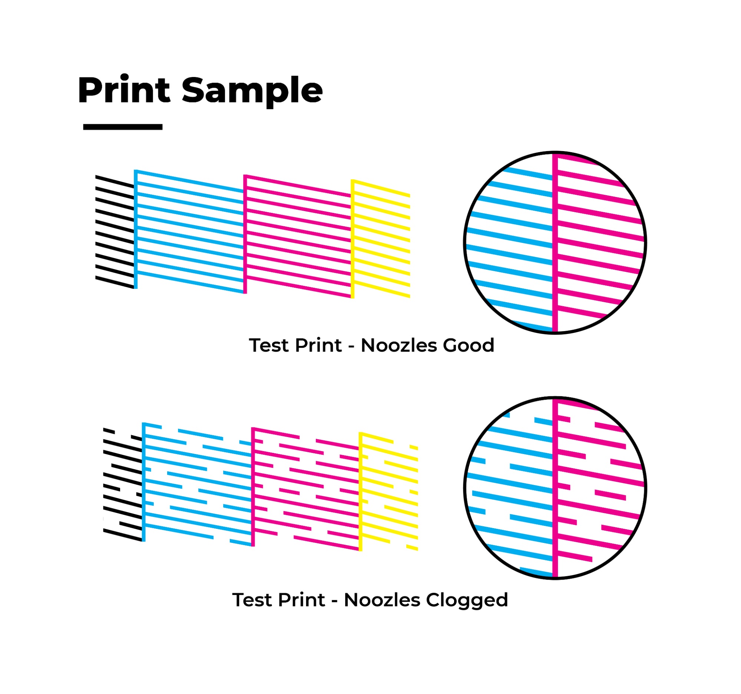
Available data and ressources
For our study, we rely on two main types of resources:
Signal data: acoustic signals captured from the piezoelectric element, providing insight into nozzle behavior and performance.
Print samples: visual test prints.

Slide 5
Project Focus
Simulating defects by varying ink pressure → this generates controlled faulty nozzle behaviors.
Printed pattern images → used only as ground truth labels, via segmentation and defect detection.
Core analysis → focused on acoustic signals recorded from the piezoelectric elements, to detect and classify nozzle jetting status

Slide 6
Objectives
1. Acoustic-based classifiers
Extract features (magnitude, phase, spectral, embeddings etc…).
Train a model.
Binary classification.
2. Relate signals to defect mechanisms
Explore link between applied pressure and acoustic signature.
3. Dynamic prediction of defects
Move from static classification → temporal modeling.
Use LSTMs/GRU/Temporal CNNs.
Predict jetting status.
4. Proof-of-concept demonstrator
Input: acoustic data → Output: jetting status / early warnings.
Evaluate accuracy across nozzles.

Slide 7
Collaboration and next steps
Access image segmentation and classification algorithm
→ generate reliable ground-truth labels.
Validate acousticmodels.
Directly support anomaly detection/predictive maintenance research.

Slide 8
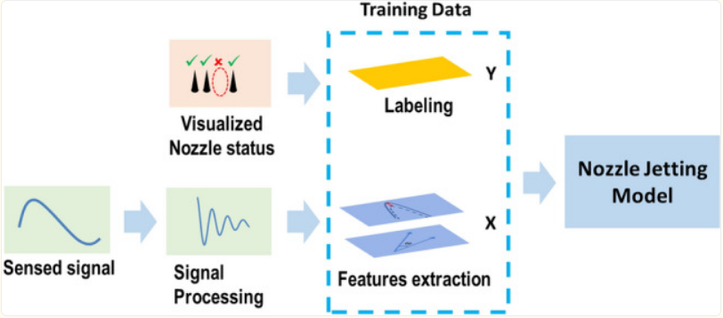
Collaboration and next steps

Slide 9
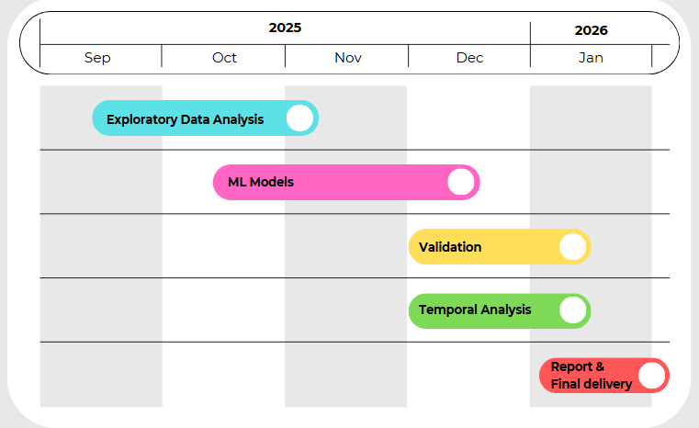
Gantt Chart

Slide 10
Thank you for your listening

Slide 11
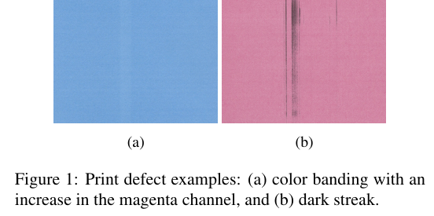
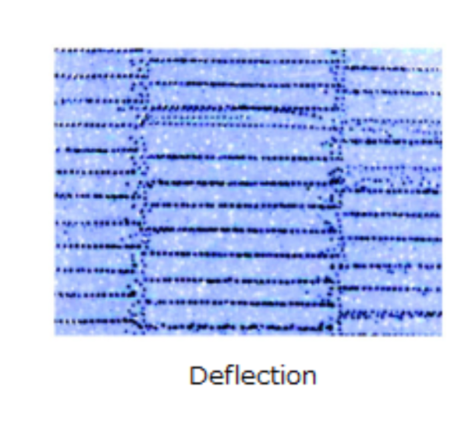
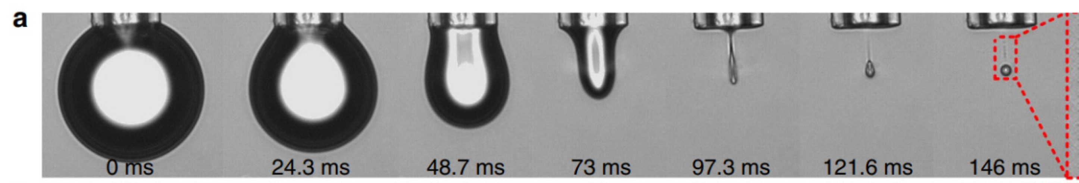
Annex

Slide 12
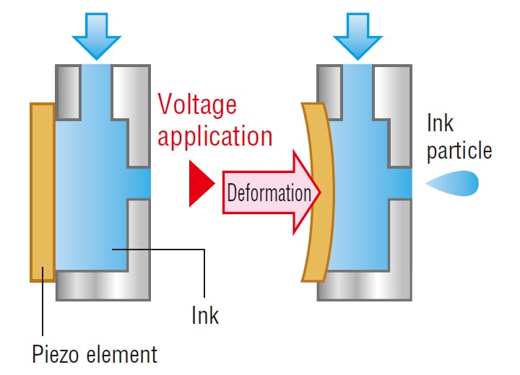
Annex

